Slide 1
Chapter 12 - Selecting a Sample
authored by Stephanie Fleischer © SAGE publications Ltd 2014

Slide 2
Topics covered
Differences in sampling in quantitative and qualitative research
Definition of sampling terminology in quantitative research
Principles of sampling
Types of sampling
Sample size
Concept of saturation point in qualitative research
authored by Stephanie Fleischer © SAGE publications Ltd 2014

Slide 3
Differences in sampling in quantitative and qualitative research
Quantitative research
Qualitative research
Unbiased
Representative
Make inferences
Random samples
Large sample sizes
Ease of access
Purpose driven
Information rich respondents
A few cases until saturation is reached
authored by Stephanie Fleischer © SAGE publications Ltd 2014

Slide 4
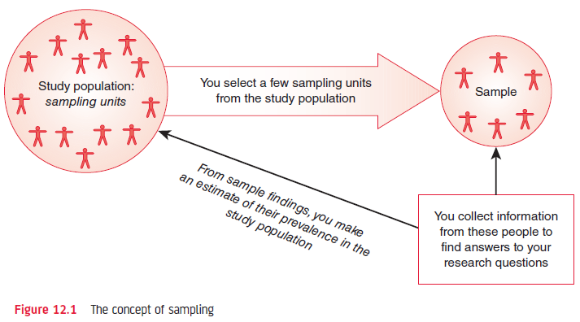
Figure 12.1 Principles of sampling
authored by Stephanie Fleischer © SAGE publications Ltd 2014

Slide 5
Sampling in quantitative research
Sampling is the process of selecting a few (a sample) from a bigger group (the sampling population) to become the basis for predicting an outcome for the bigger group.
Advantage: Researching a sample is easier
Disadvantage: The sample and the sampling population differ
authored by Stephanie Fleischer © SAGE publications Ltd 2014

Slide 6
Sampling terminology
Study population is the group the sample is taken from
Sample size refers to the number of items/people in the sample
Sampling frame is a list of each item/person in the study population
Sample statistics are the results found in the sample
Population parameter are the estimates for the population from the sample statistics
authored by Stephanie Fleischer © SAGE publications Ltd 2014

Slide 7
Principles of Sampling
There will be a difference between the sample statistics and the true population mean, which is attributable to the selection of the units in the sample.
The greater the sample size, the more accurate the estimate of the true population mean.
The greater the difference in the variable under study in a population, for a given sample size, the greater the difference between the sample statistics and the true population mean.
authored by Stephanie Fleischer © SAGE publications Ltd 2014

Slide 8
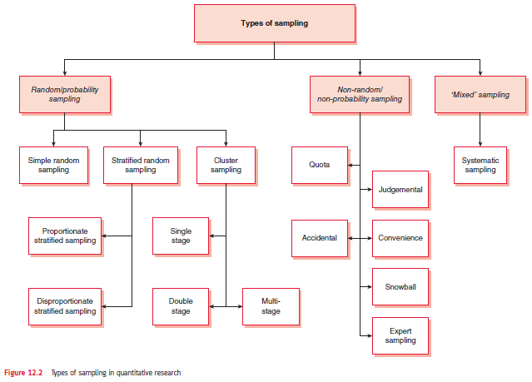
Figure 12.2 Types of sampling
authored by Stephanie Fleischer © SAGE publications Ltd 2014

Slide 9
Random/Probability sampling designs
Each element in the sampling frame has an equal and independent chance of selection in the sample
Advantages:
Representative of the total sampling population, the inferences drawn from such samples can be generalised to the total sampling population.
Some statistical tests based upon the theory of probability can be applied only to data collected from random samples.
authored by Stephanie Fleischer © SAGE publications Ltd 2014

Slide 10
Specific random sampling designs
Simple random sampling (SRS)
Stratified random
Cluster sampling
Systematic sampling
authored by Stephanie Fleischer © SAGE publications Ltd 2014

Slide 11
Non-random/ non-probability sampling designs
Quota sampling
Accidental sampling
Judgmental or purposive sampling
Expert sampling
Snowball sampling
authored by Stephanie Fleischer © SAGE publications Ltd 2014

Slide 12
Sample size
The greater the heterogeneity or diversity in what to be found out about, the greater the number of respondents needed to contact to reach saturation point.
Cause-effect studies need to consider:
Level of confidence
Degree of accuracy
Level of variation
authored by Stephanie Fleischer © SAGE publications Ltd 2014

Slide 13
Concept of saturation point in qualitative research
Qualitative research uses non-probability sampling
Collecting information from a predetermined number of people
Sampling until saturation point is reached (no new information collected)
Guided by judgment as to who is likely to provide the ‘best’ information.
authored by Stephanie Fleischer © SAGE publications Ltd 2014

Slide 14
Summary
Quantitative research wants to represent the sampling population which is best achieved through random sampling
Qualitative research uses non-random sampling with a purpose to collect the best information from the sample
authored by Stephanie Fleischer © SAGE publications Ltd 2014

